Slide 1
TCP Stability and Resource Allocation: Part I
R. Srikant
University of Illinois

Slide 2
References
The Mathematics of Internet Congestion Control, Birkhauser, 2004.
The web pages of
  Kelly, Vinnicombe, Massoulie
  Low, Paganini, Doyle
  Hollot, Misra, Towsley
  Floyd
  Kunniyur, Shakkottai, Deb, Basar, S.

Slide 3
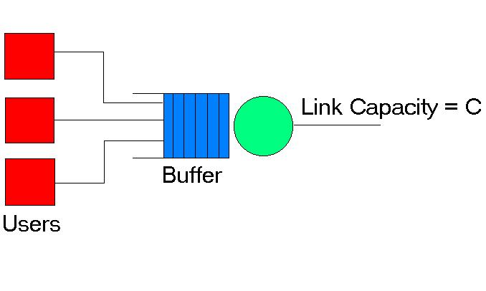
What is Congestion?
Multiple users accessing same link
When arrival rate exceeds capacity, queue length increases
Buffer Overflow
Dropped packets

Slide 4
Congestion indication and Control
At the router
    Packets marked or dropped based on queue length (Active Queue Management)
    Losses or Marks serve as congestion indicators
At the source
    Source increases transmission rate when there is no congestion
    Decreases rate upon receiving a mark or detecting a loss

Slide 5
Window Flow Control
W: Window size of a source
W is the number of unacknowledged packets that can be in the network
In other words, initially W packets can be sent into the network
After this, one new packet can be transmitted every time the source receives an ack from the destination

Slide 6
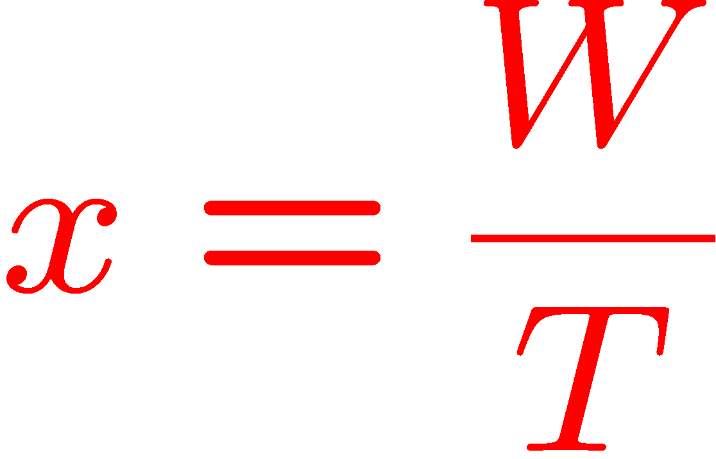
Window to Rate
x: Transmission rate (packets/sec.)
T: Round-trip time. Amount of time it takes to receive an ack for a packet
Assume packet processing time is negligible. Thus, the source sends W packets once every RTT
Thus,

Slide 7
Adaptive Window Flow Control
Many sources using a link of capacity c
Ideally, we would like ∑_{i} x_{i}· c
The available capacity is unknown to the sources
Each source gets information from the receiver about lost packets
Jacobson’s algorithm in TCP: regulates the window size based on packet loss feedback

Slide 8
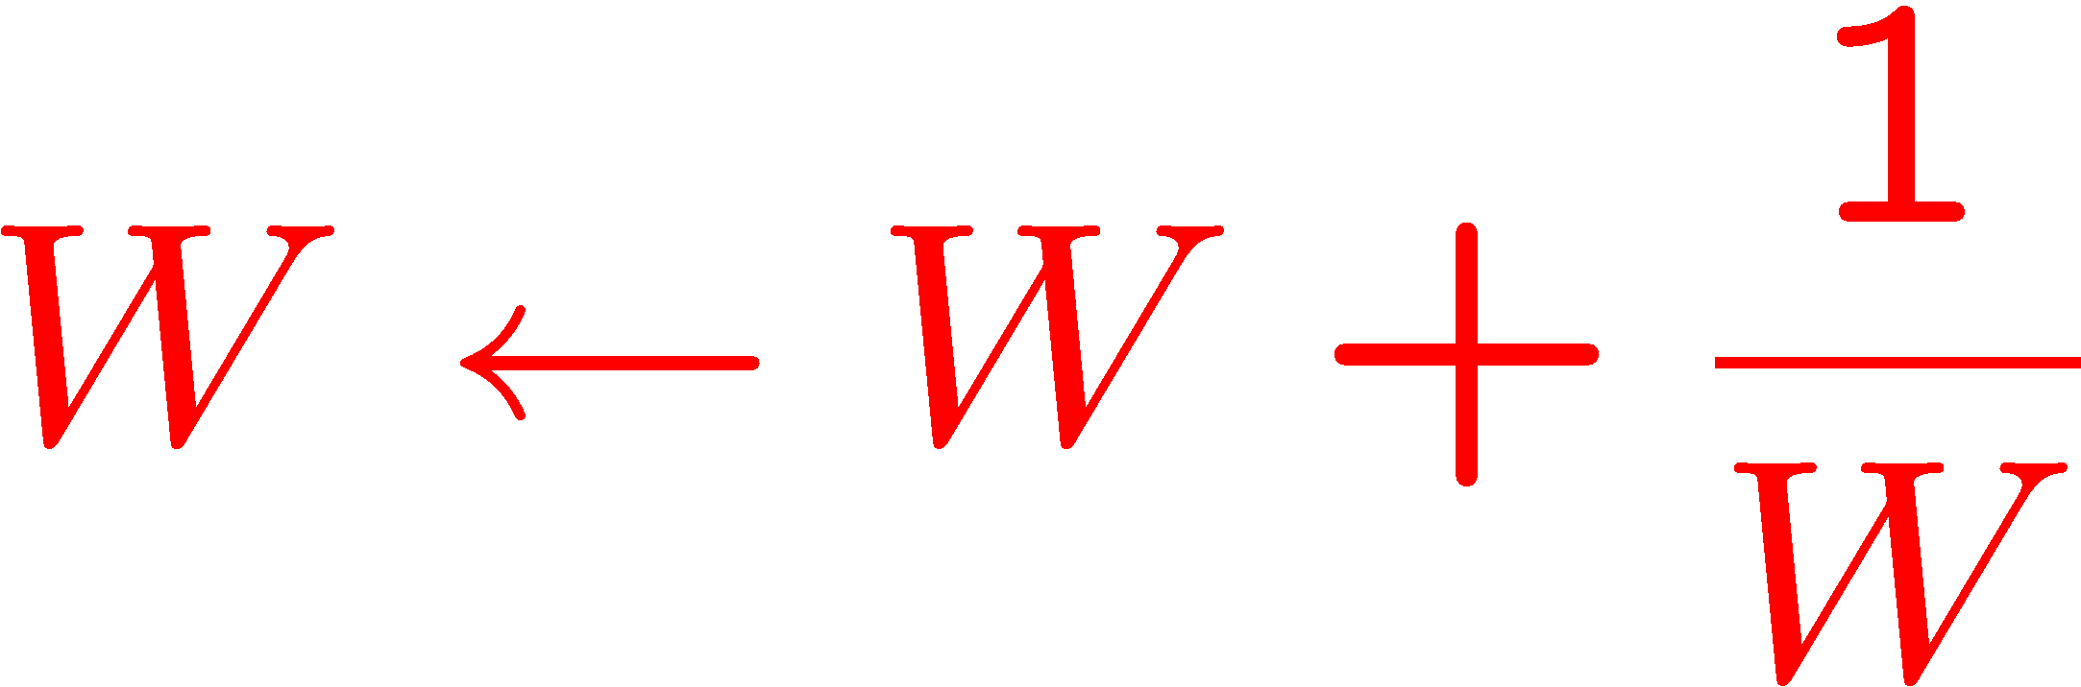
Simplified TCP Dynamics - I
For every received ack,
Increase window size when no congestion is detected
Ack: When it receives a packet, the receiver sends the id of the next packet that it expects

Slide 9
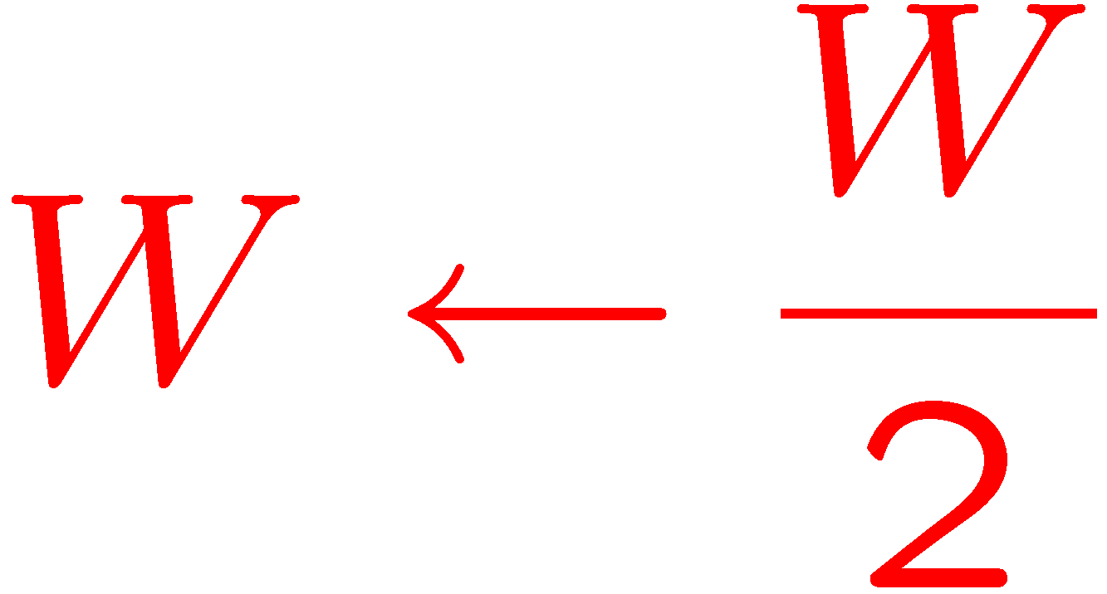
Simplified TCP Dynamics - II
Three acks with the same packet id: Source assumes that a packet is lost
Upon detecting a loss, source sets
Reduce window size when congestion is detected

Slide 10
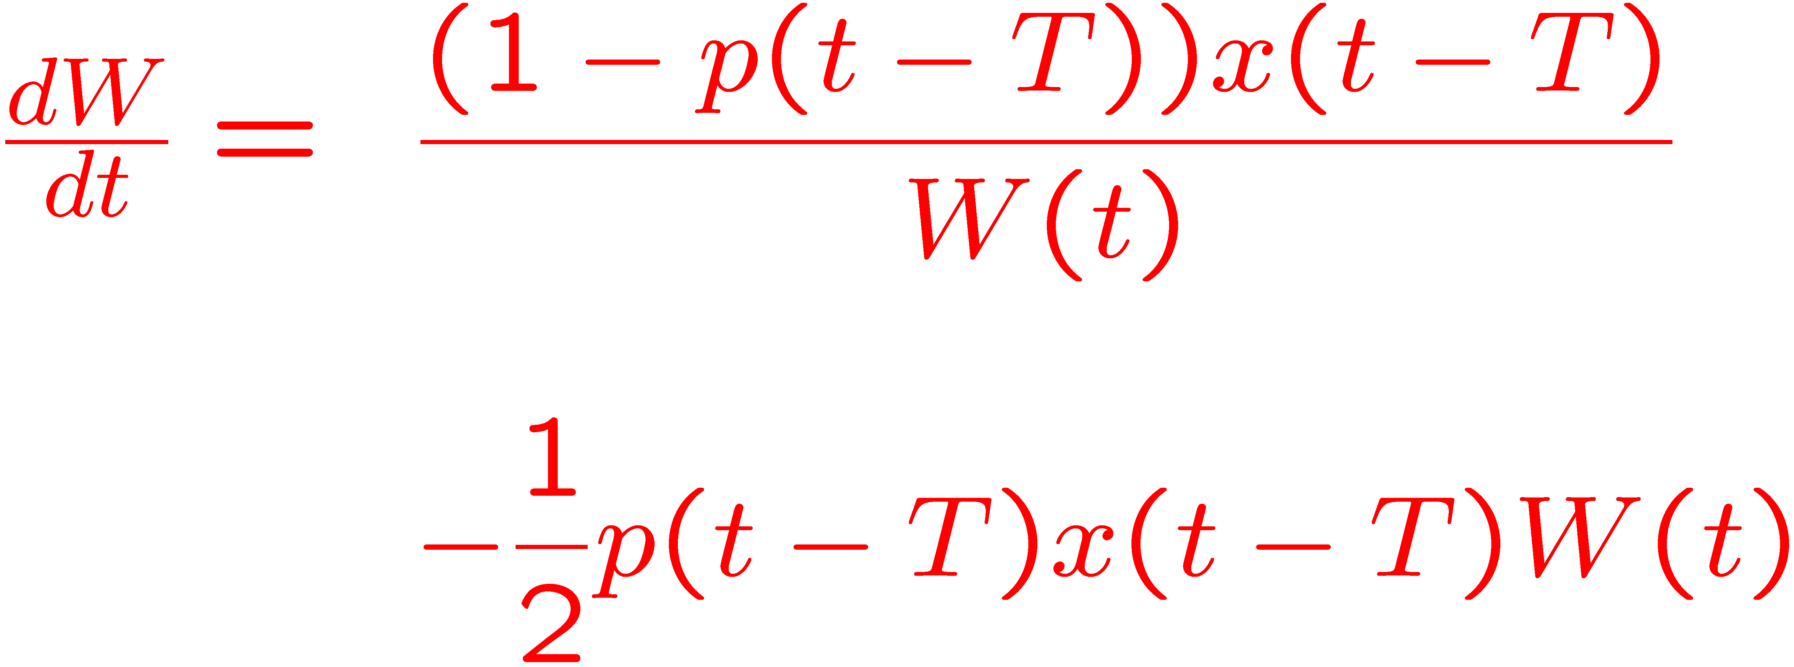
Differential Equation - I
p(t): Probability of packet loss at time t

Slide 11
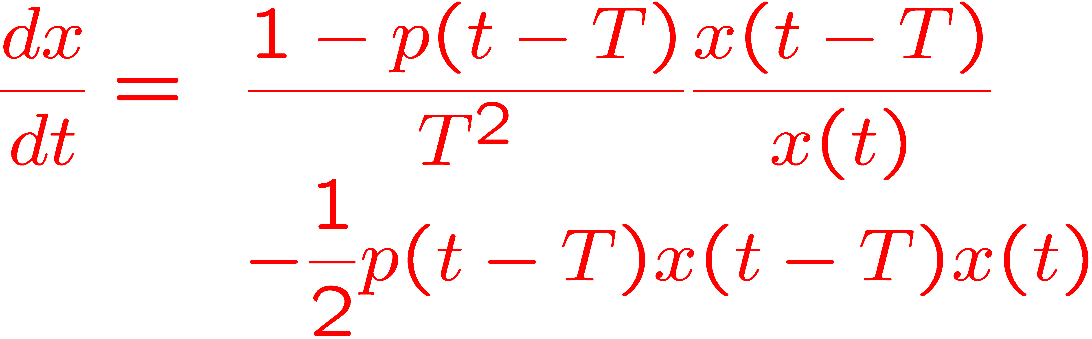
Differential Equation - II
Additive Increase-Multiplicative Decrease (AIMD)

Slide 12
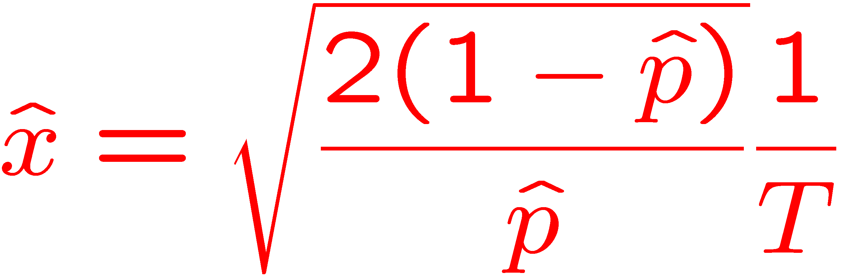
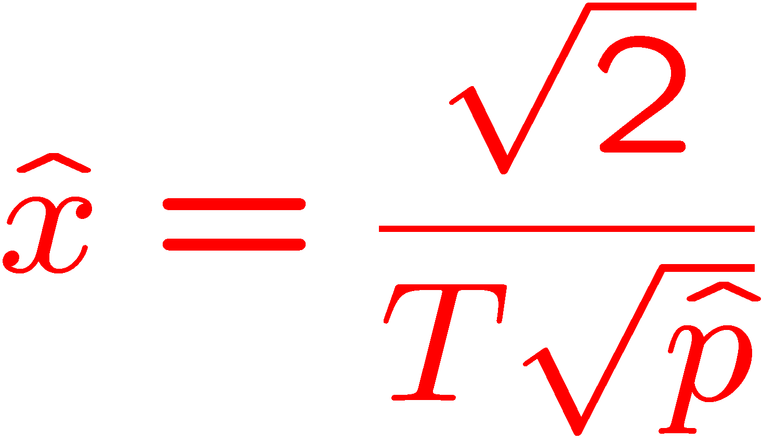
Equilibrium
RTT bias: TCP throughput depends inversely on the RTT
Usually approximated as

Slide 13
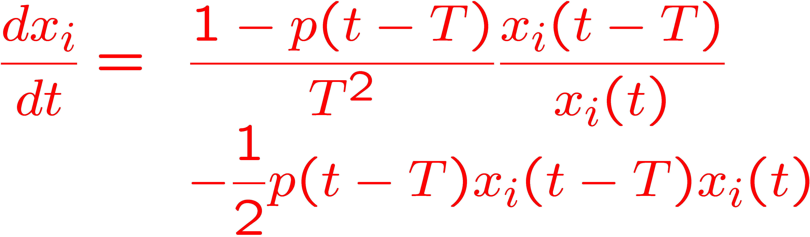
Multiple Sources, Identical RTTs

Slide 14
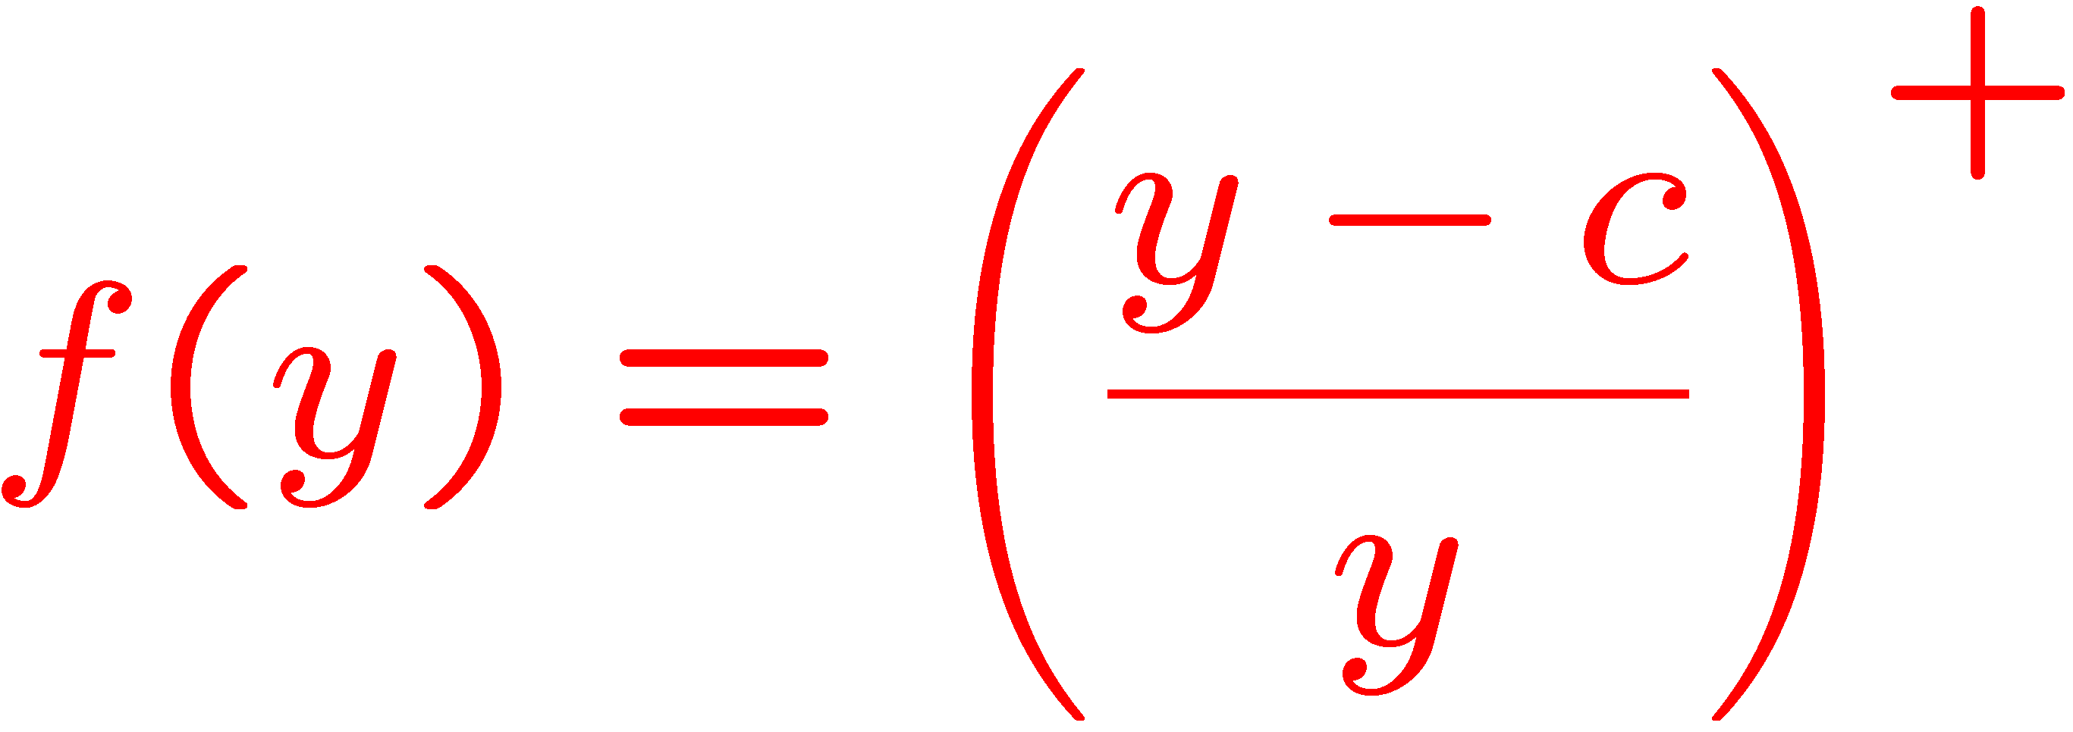
Model for packet loss probability
B
In general, p(t)=f(y(t),B,c), where y=∑_{i} x_{i}
Large system approximation:
Arrival rate y
c packets/sec.

Slide 15
Stability
Global stability: does the system converge to its equilibrium point starting from any initial condition?
Local stability: does the system converge to its equilibrium point when the initial condition is close to the equilibrium?
We will only answer the second question.

Slide 16
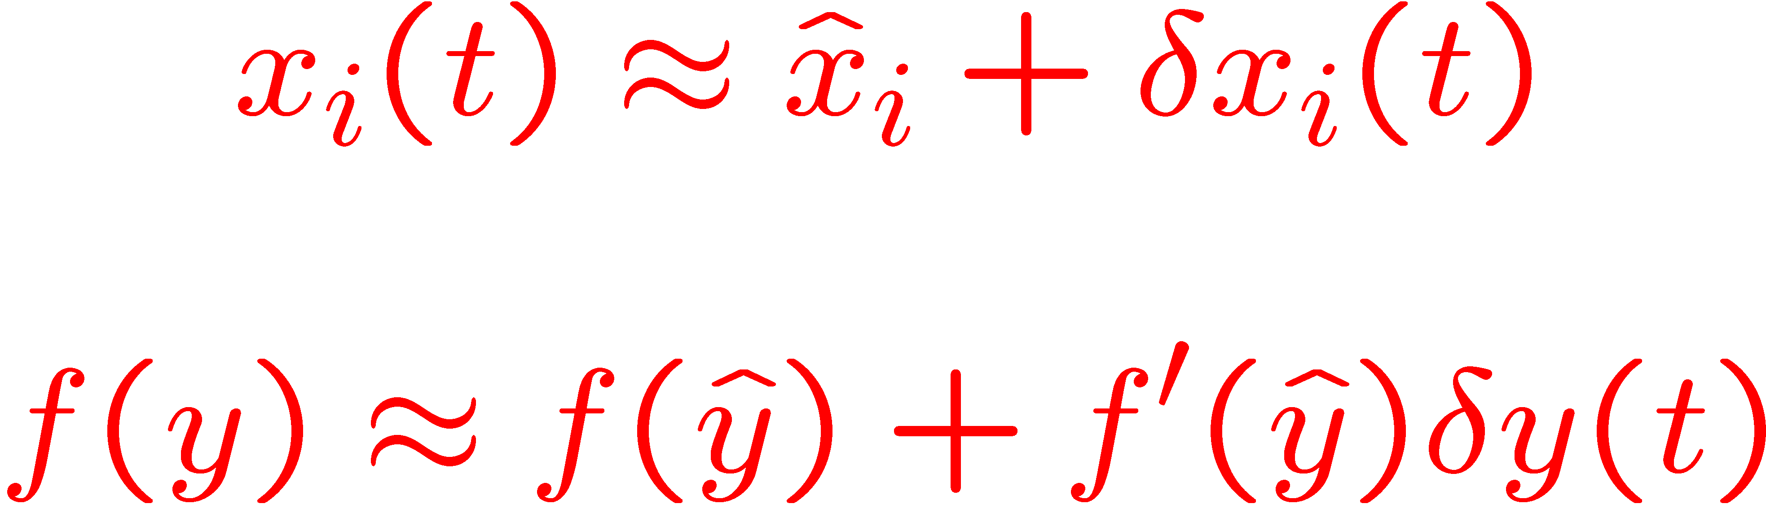
Linearization
To verify local stability, linearize and check for stability in the frequency domain (Laplace transform)
Ignore O((δ x_{i})²) and higher order terms

Slide 17
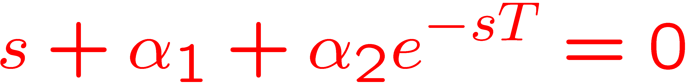
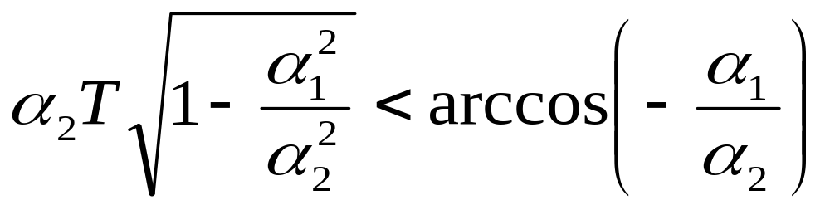
Stability Analysis
Roots must lie in the complex left-half plane:
Stability condition (Hayes): Either (i) α₁¸α₂ or (ii) α₁<α₂ and

Slide 18
TCP-Reno is not scalable
1 packet=8,000 bits
C=125,000 packets (1 Gbps)
B=1250 packets (max queueing delay = 10 msec.)
Number of Users=1000
TCP is unstable for RTT > 25 msecs or about 1,000 miles
Problem worsens when the throughput per user increases

Slide 19
TCP and Resource Allocation
User 1
c_{A}
c_{B}
User 0
User 2
How much bandwidth should each user get?
Constraints: x₀+x₁· c_{A}; x₀+x₂· c_{B}

Slide 20



Utility Functions
User 1
c_{A}
c_{B}
User 0
User 2
Associate a utility function with each user
Strictly concave, increasing functions
Maximize system utility, i.e., the sum of the utilities of all the users

Slide 21
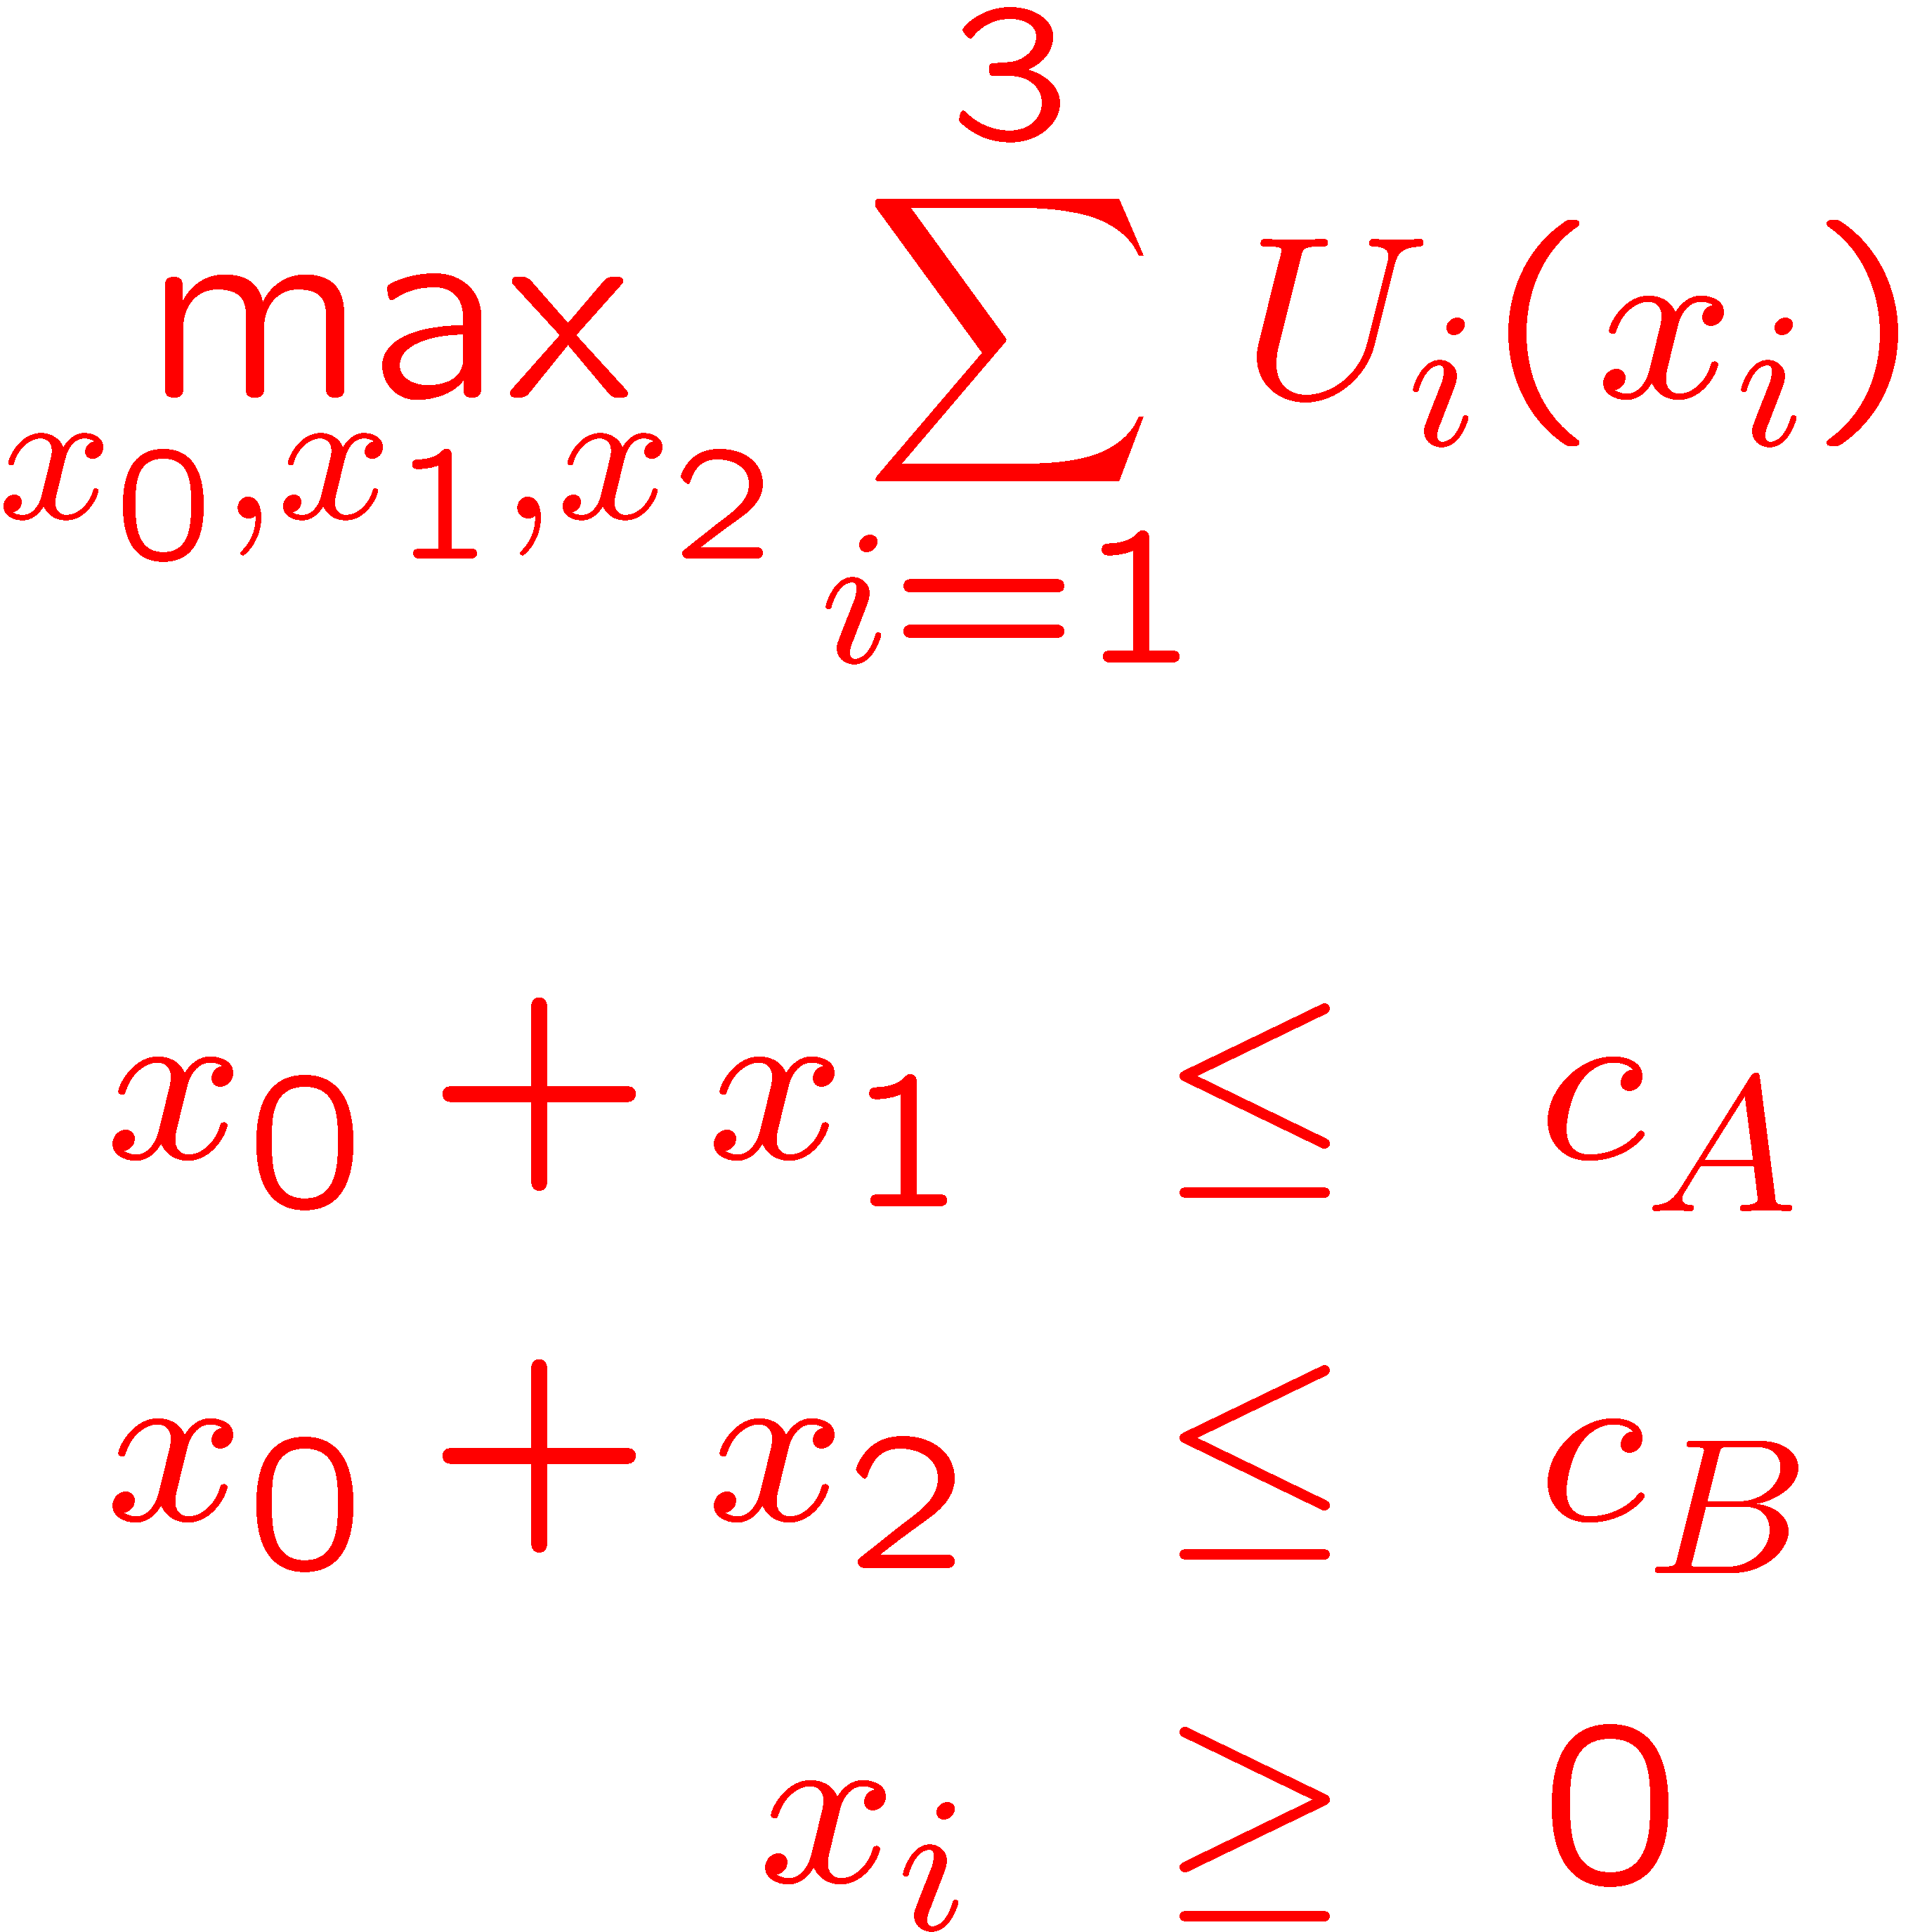
Kelly’s System Problem
subject to

Slide 22
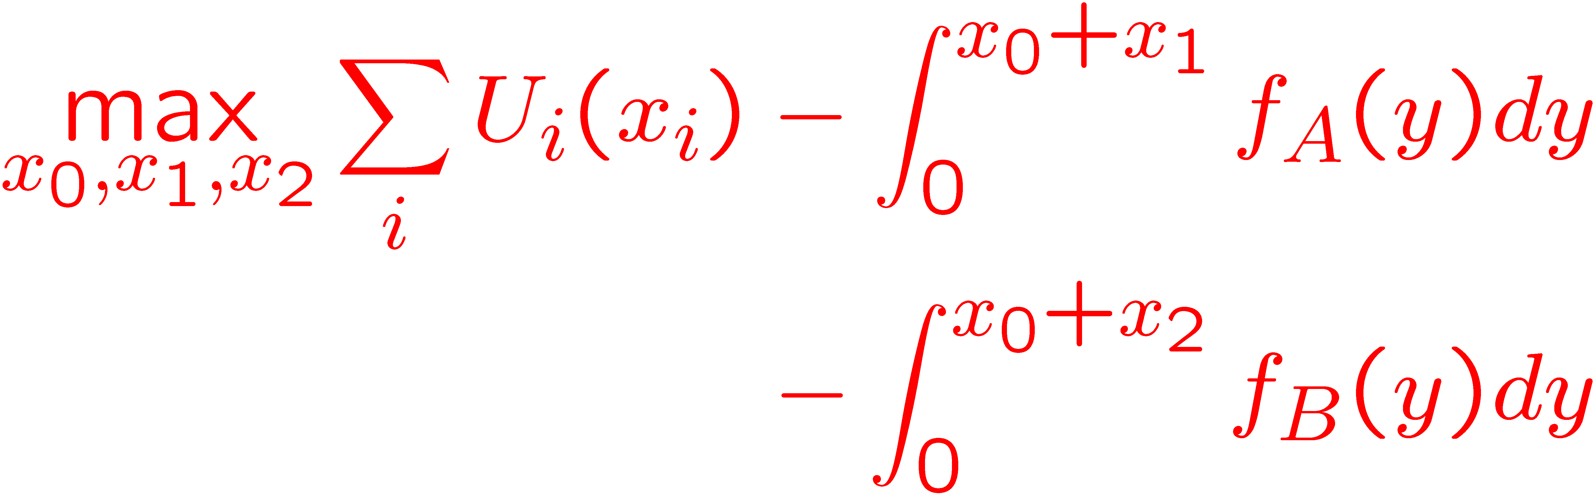
Link Price Formulation
Associate a price function with each link: p_{l}(y_{l}), where y_{l} is the arrival rate into the link

Slide 23
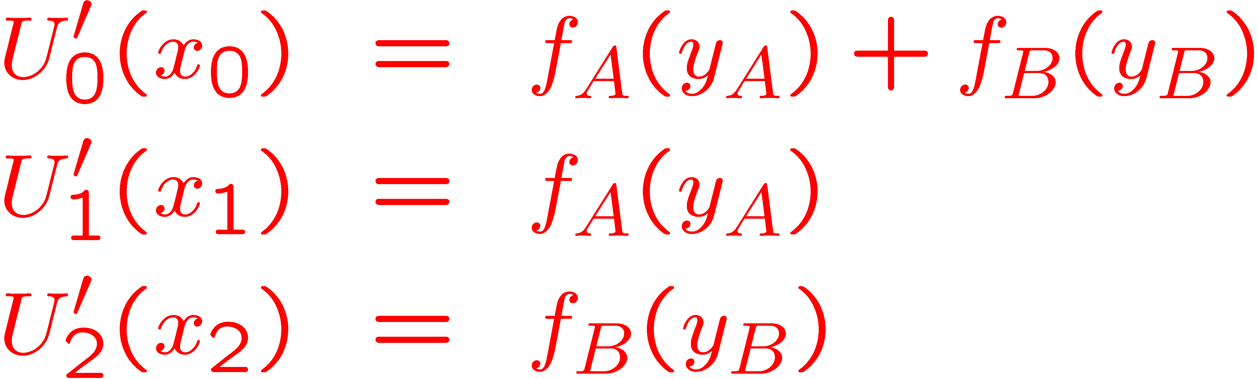
Solution
User i’s depends only on its path price
Link price depends only on the total arrival rate into the link

Slide 24
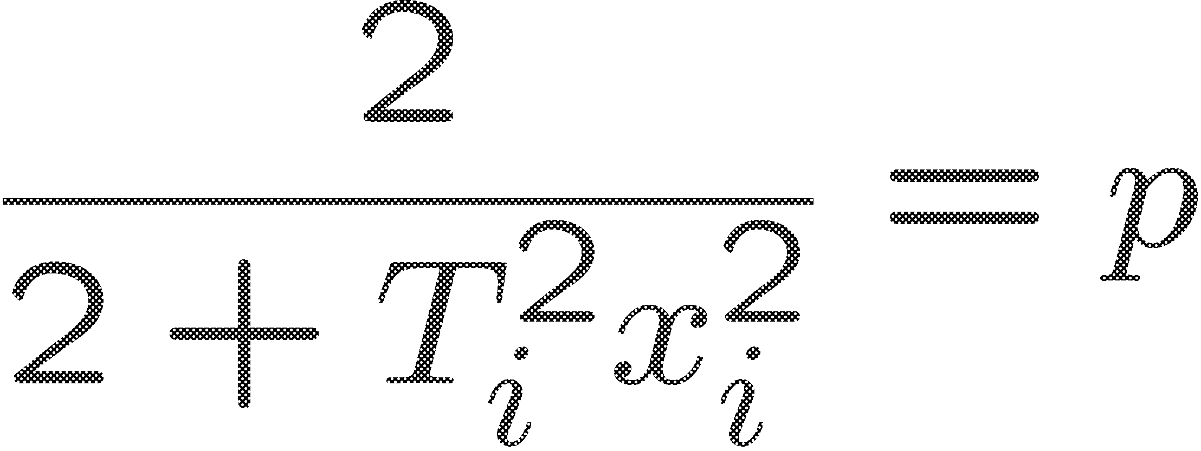
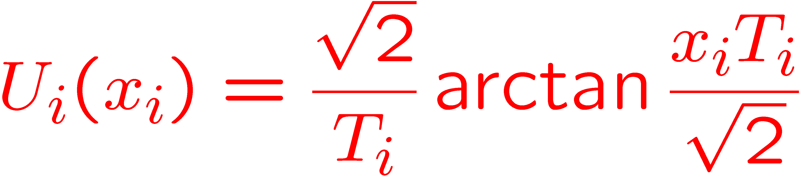
TCP-Reno
TCP-Reno in equilibrium:
Utility function:

Slide 25
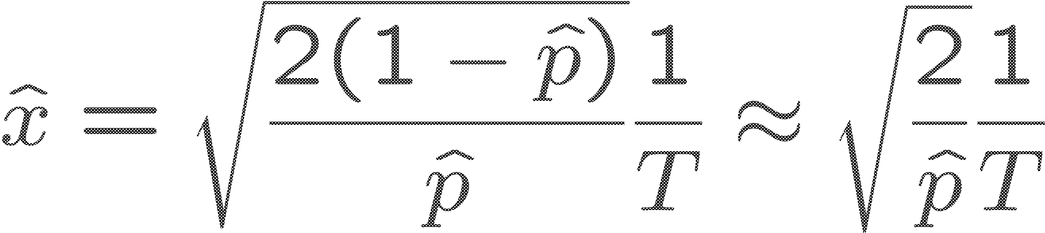
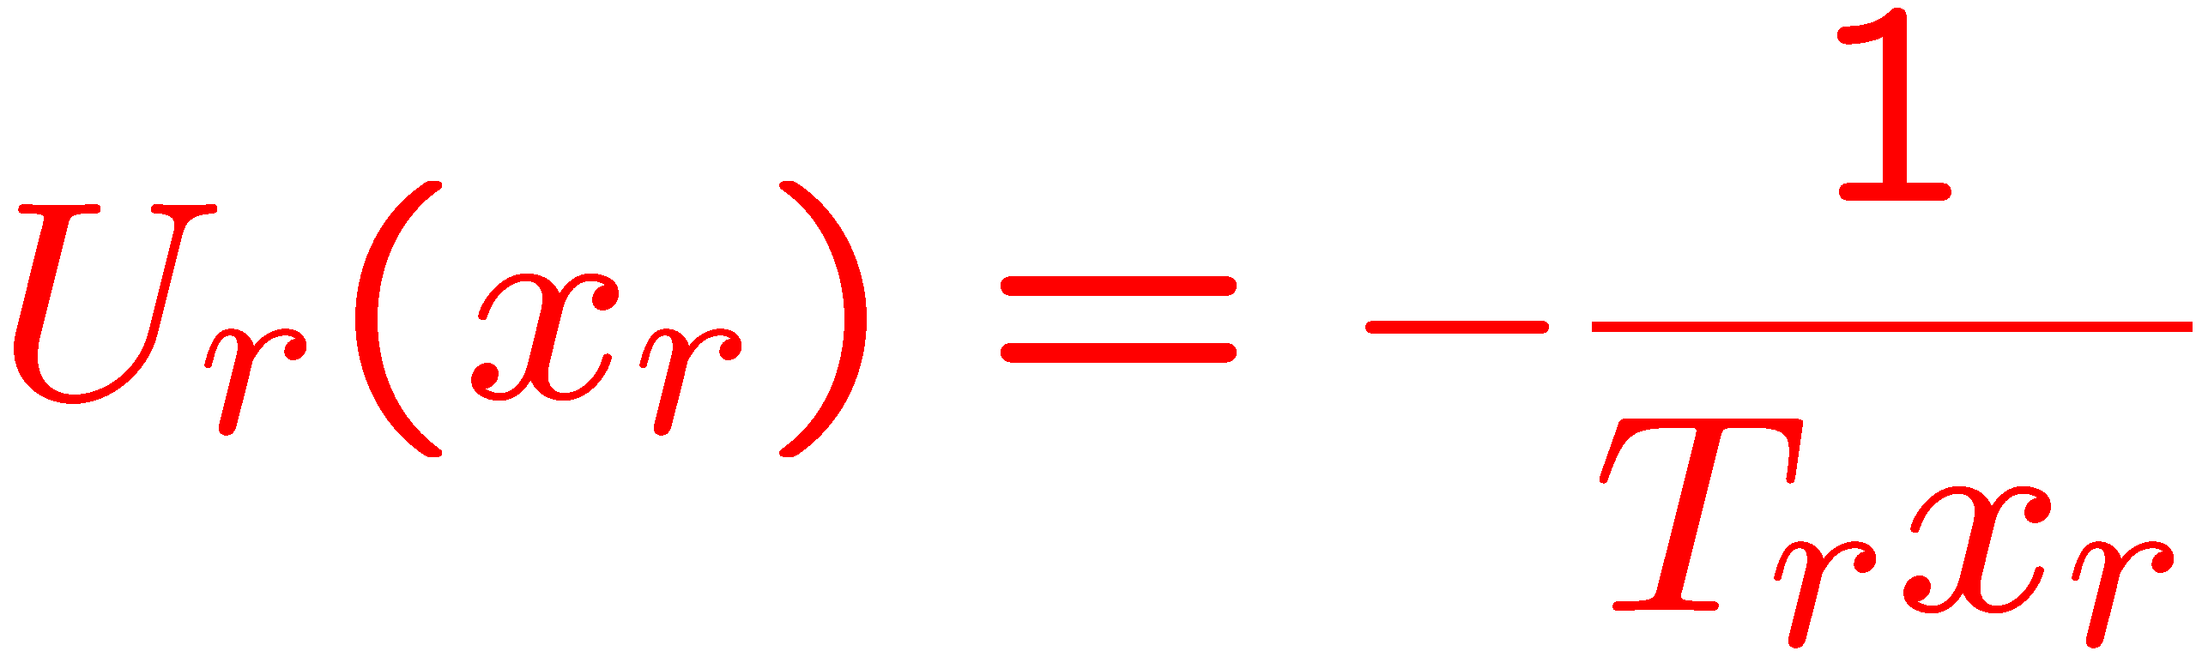
Simplified TCP-Reno
Suppose
Then,
Interpretation: Minimize (weighted) delay

Slide 26
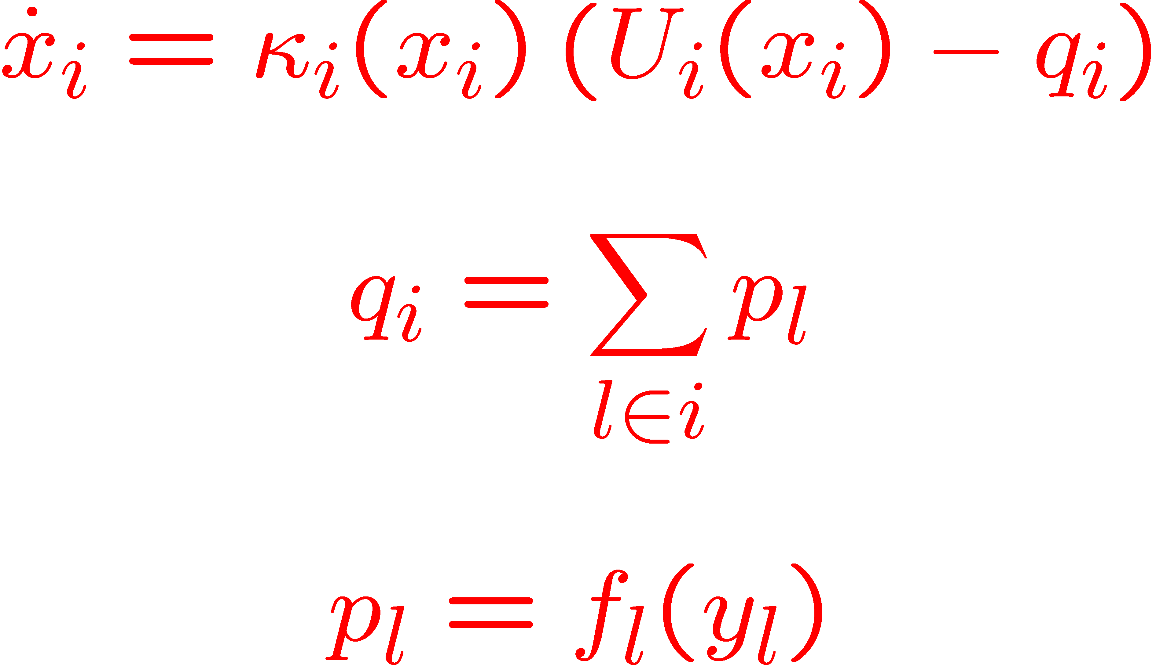
TCP: A Decentralized Solution to the Resource Allocation Problem

Slide 27
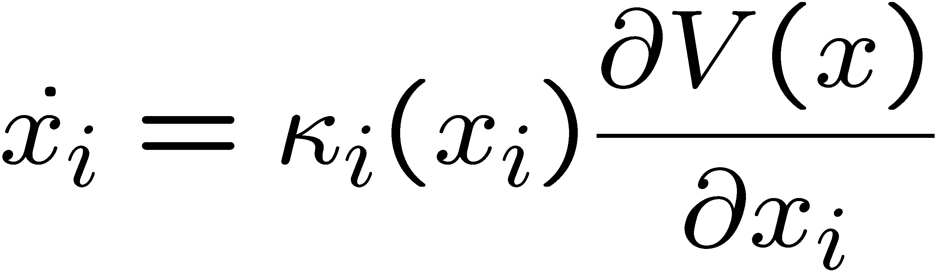
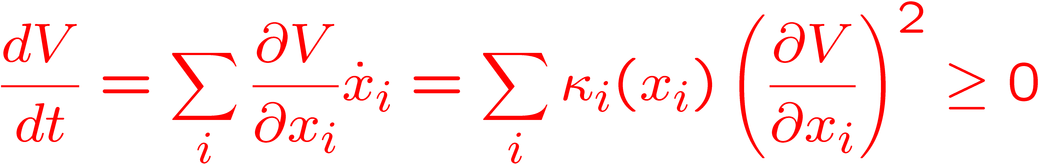
Convergence
Note that
V(x) is the resource allocation objective
V(x) is a Lyapunov function:

Slide 28
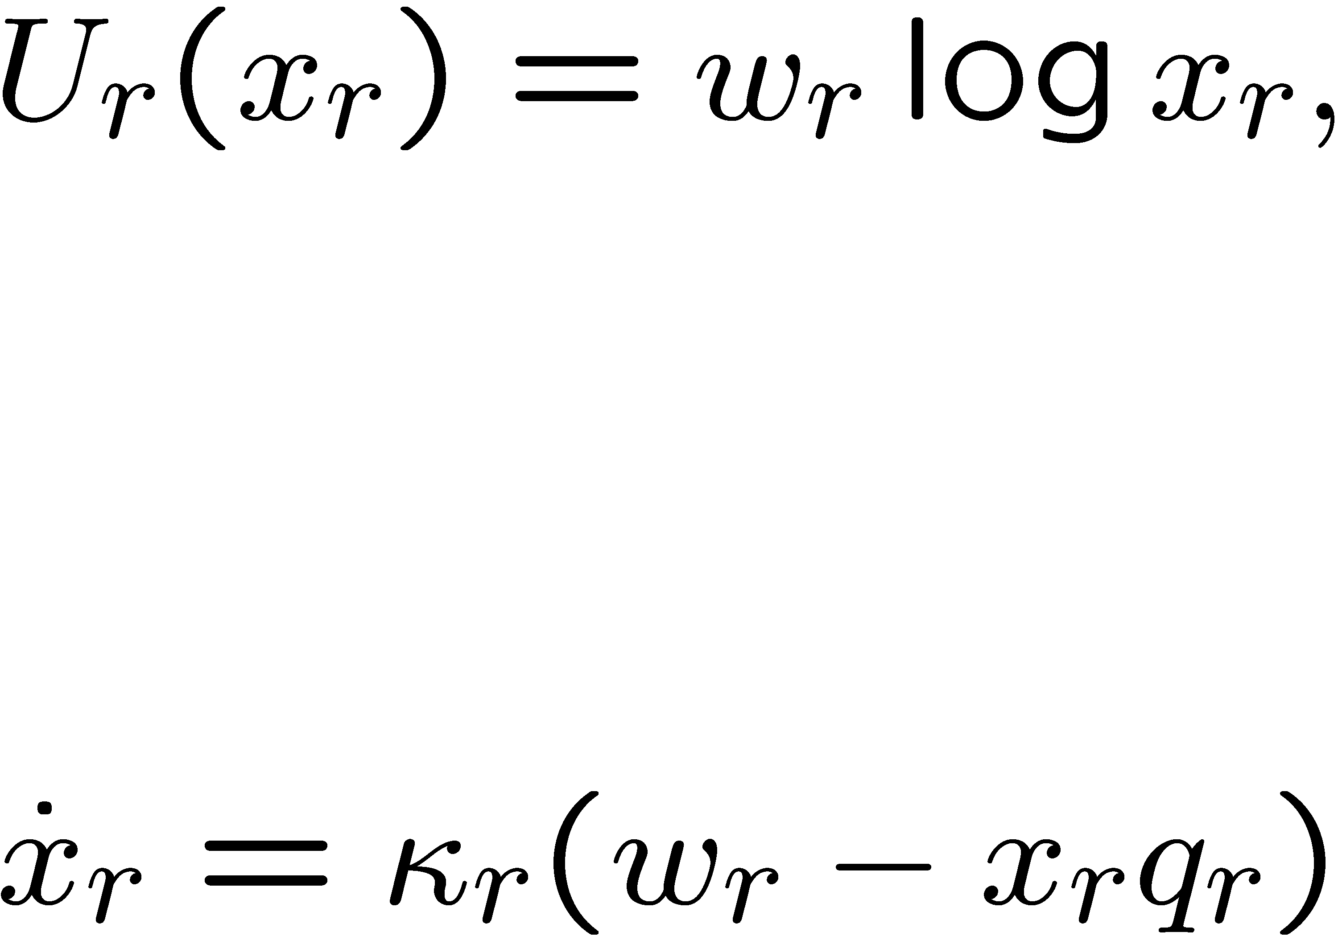
Proportionally-Fair Controller
If the utility function is
then a controller that implements it is given by

Slide 29
Price versus Probabilistic Feedback
Price: q_{i}=∑_{l2 i} p_{l}
Loss Probability: q_{i}=1-∏_{l2 i}(1-p_{l}). If the p_{l}’s are small, they are approximately equal
Else, TCP solves a modified version of the resource allocation problem

Slide 30
Alternate views: Duality
Primal Algorithm: The source is dynamic. Link feedback is static
Dual Algorithm: Static source and dynamic link feedback
Primal-Dual Algorithm: Dynamic Source and dynamic link feedback

Slide 31
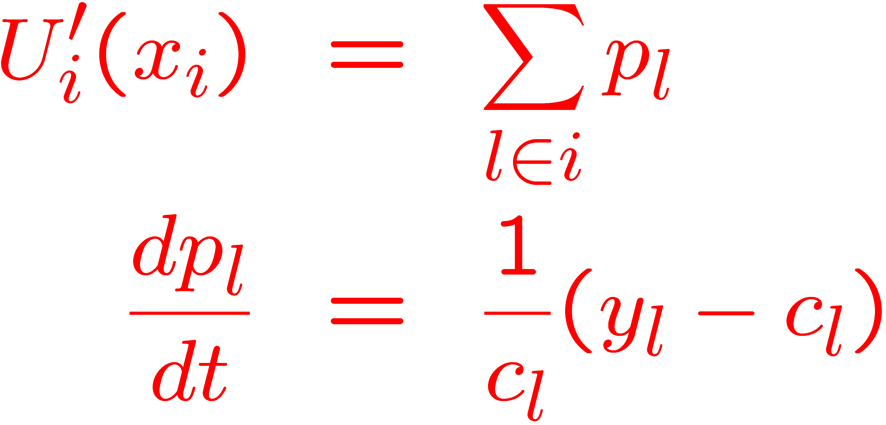
Dual Algorithm
p_{l} is the delay at link l
TCP-Vegas: Modify source rates in response to measured delay

Slide 32
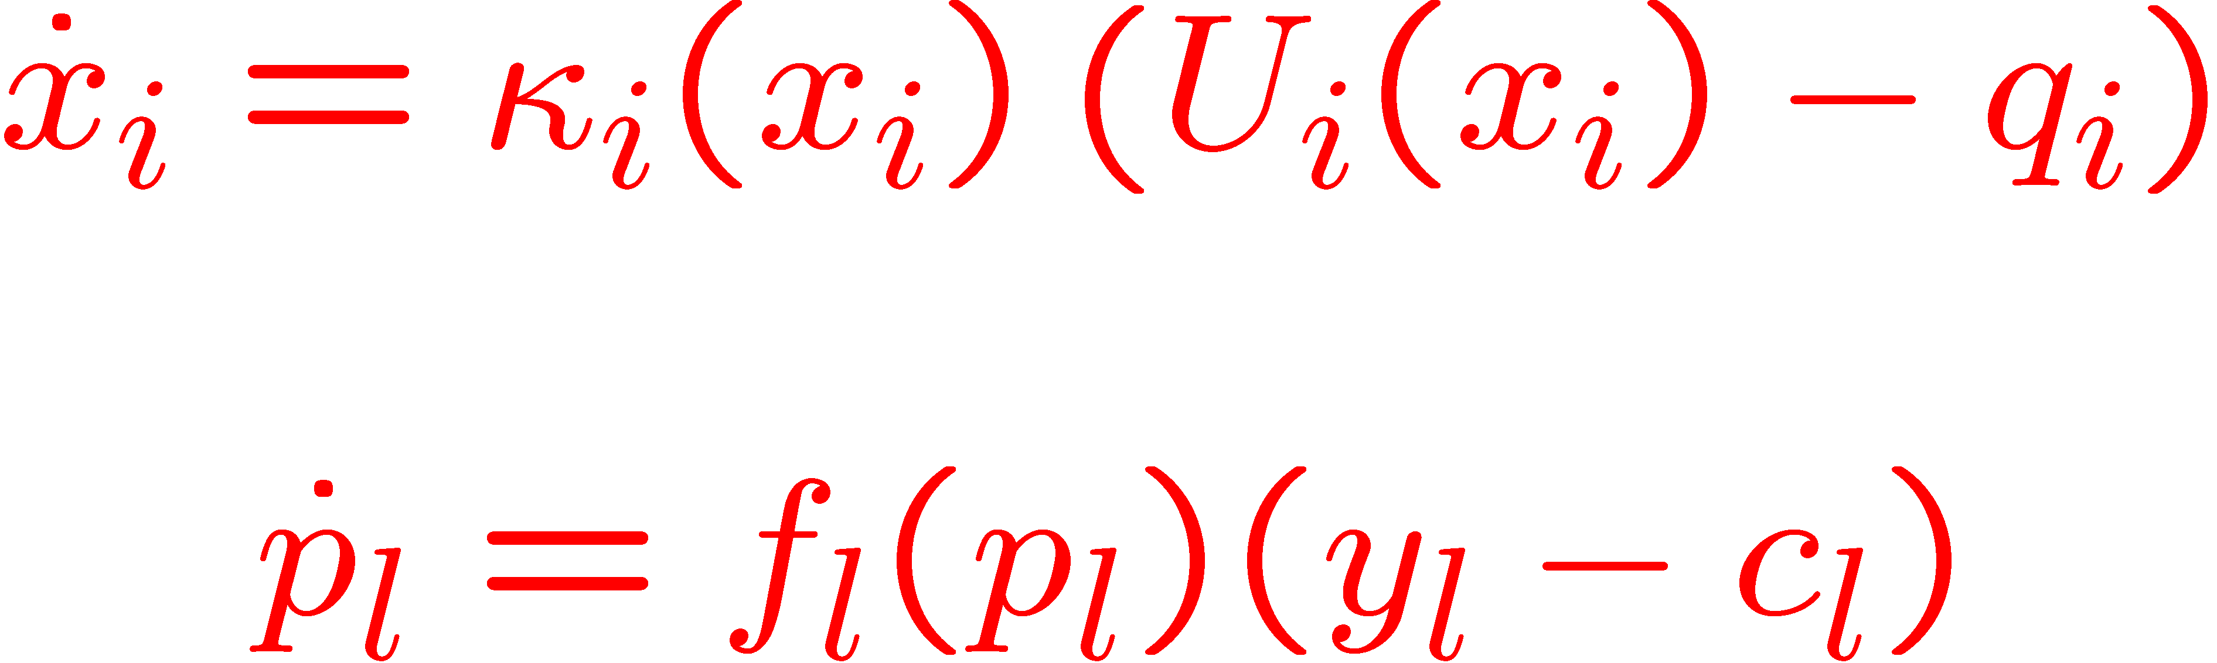
Primal-Dual Algorithm
Source can be TCP-Reno
Feedback generated by active queue management algorithms

Slide 33
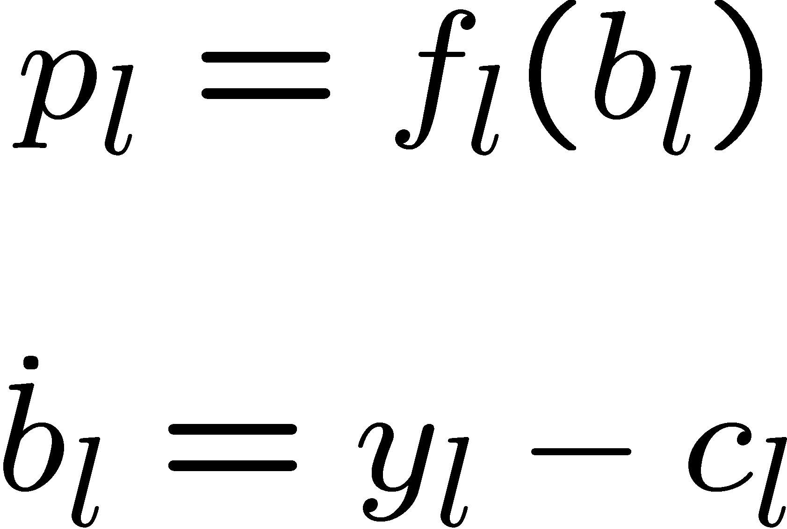
Active Queue Management
The feedback is a function of the queue length

Slide 34
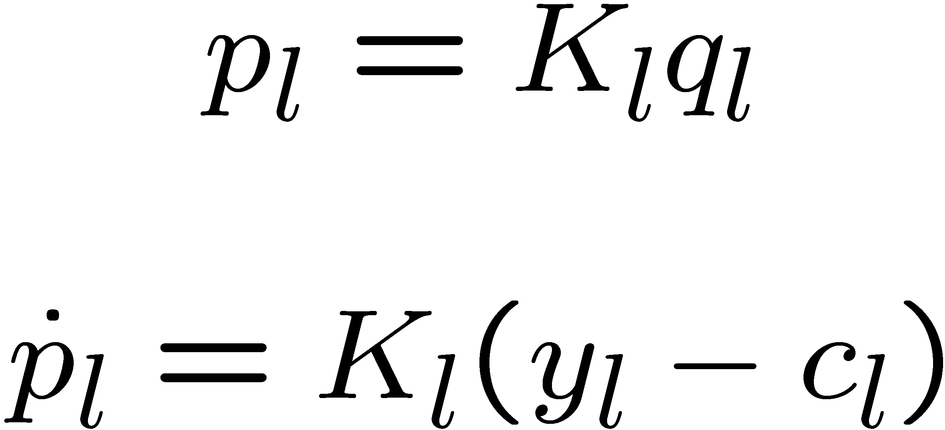
Random Early Detection (RED)
Simplified view:

Slide 35
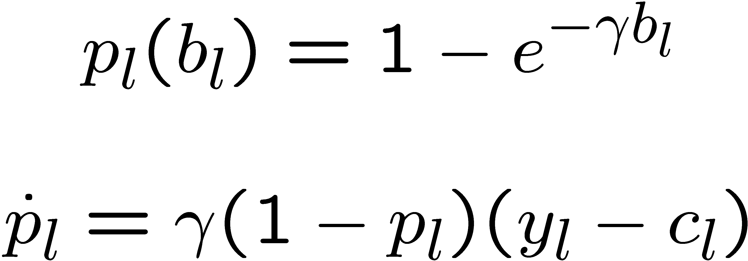
Random Early Marking (REM)

Slide 36
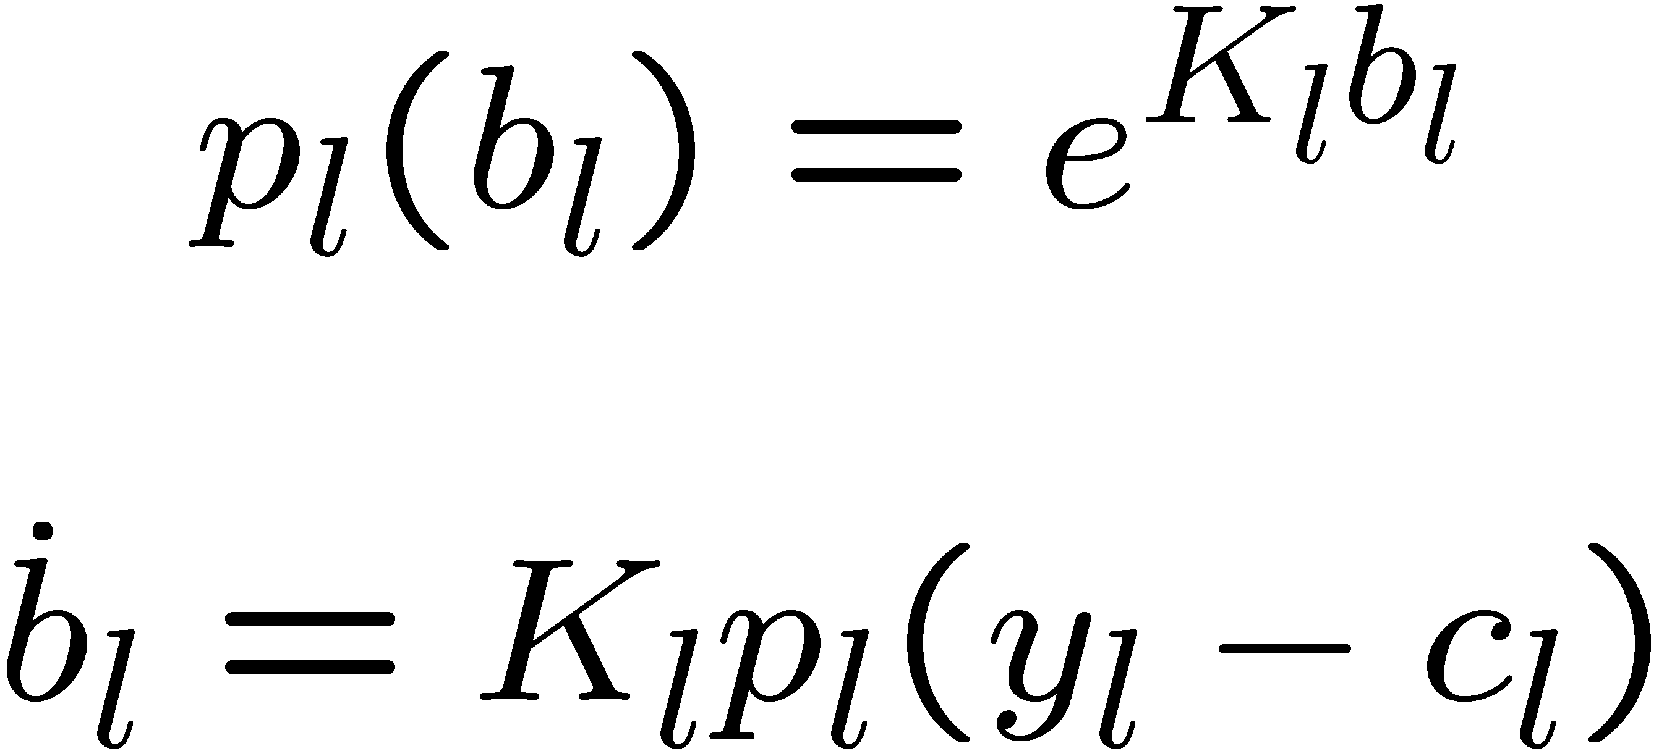
Exponential-RED

Slide 37
Explicit Congestion Notification (ECN)
Instead of dropping packets, mark packets to indicate incipient congestion
Marking: Router flips a bit in the packet header from 0 to 1 to indicate congestion
Destination echoes the ECN bit back to the source in the ack

Slide 38
Part II
Stable, scalable enhancements to TCP
Stability conditions for a network
Connection-level modeling
Open problems

